Slide 1
LEADERSHIP II FOR FIRE AND EMS: STRATEGIES FOR PERSONAL SUCCESS ETHICS

Slide 2
Objectives
The students will:
Identify the importance and impact of ethics on the fire department/emergency medical services (EMS) and its members.
Identify the roles of the fire/EMS office establishing, modeling, and managing ethical behavior.
Analyze their own department's existing ethical rules and guidelines, and where the gaps might be
Demonstrate decisionmaking involving ethical practices.

Slide 3
Overview
Ethics and Their Impact
Sample Code of Ethics (from ASPA)
Guidelines and Resources
Characteristics of an Ethical Organization and an Ethical Leader

Slide 4
Activity ET.1
Ethics at Any Level

Slide 5
Ethics and Their Impact
One of the greatest desires of most fire/ EMS officers is to provide service in an honorable way and to follow a long history of leaders who performed great good to great numbers of people.
This module will assist you in sorting out the ethical demands placed upon you and in preparing for ethical challenges in the future.

Slide 6
Ethics and Their Impact (cont'd)
How do you feel personally about receiving a 10 percent discount at certain local restaurants when you are in uniform?

Slide 7
Ethics and Their Impact (cont'd)
Ethics is
Given system of conduct
Principles of honor or morality
Guidelines for human action
Rules or standards for individuals or professions
Character of a group

Slide 8
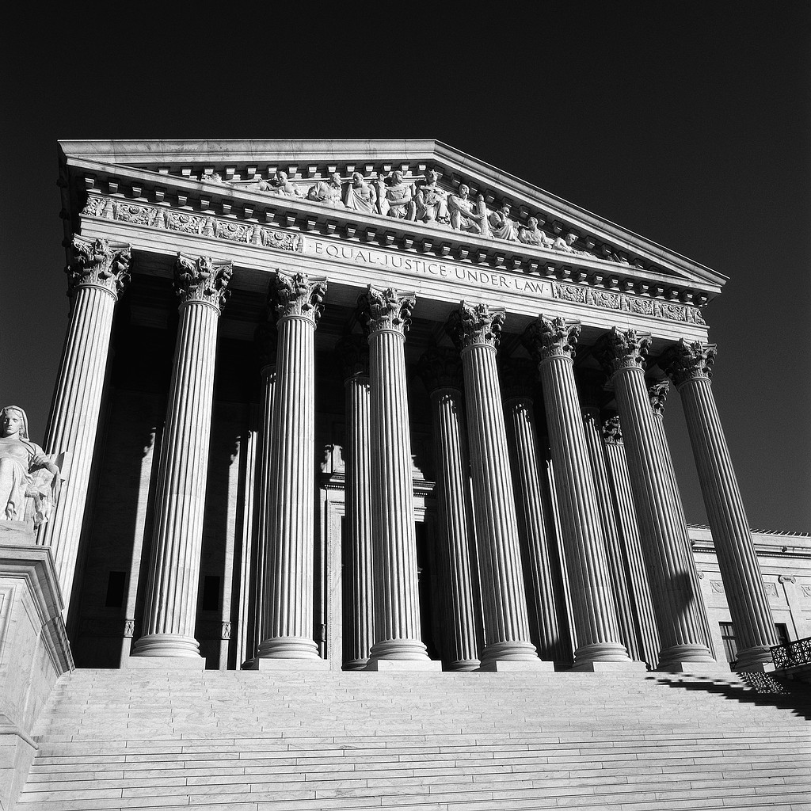
Ethics and Their Impact (cont'd)
Ethics have roots in:
Ancient history
Religion
Systems of law
Social customs
Our own personal code of conduct

Slide 9
Ethics and Their Impact (cont'd)
Codes of ethics
Provide specific guidelines
Informs of a common set of standards
Encourage members to live by those standards
Purpose is to protect integrity and reputation

Slide 10
Hippocratic Oath
A well-known code of ethics is the Hippocratic Oath of physicians, which states in part, "Above all, do no harm." How many of you belong to an organization that has a published code of ethics? What types of statements are included?

Slide 11
Ethics and Their Impact (cont'd)
Spell out standards of behavior for:
Professional life
Example: "They will recognize his badge of office as a symbol of public faith, and accept it as a public trust to be held as long as they are true to the ethics of their office." (Fire Marshal's Association of America.)

Slide 12
Ethics and Their Impact (cont'd)
Spell out standards of behavior for (cont'd):
Relations with the public or society
Example: "Be courteous, considerate, enthusiastic, and cooperative. Be especially tactful and considerate in dealing with those who have experienced a loss due to fire." (Firefighter's Ten Commandments; Carl E. McCoy, author.)

Slide 13
Ethics and Their Impact (cont'd)
Spell out standards of behavior for (cont'd):
Relations with employers
Example: "Not accept, for the same service,
compensation of any kind (other than from the client, principal, or employer) without full disclosure, knowledge, and consent of all parties concerned." (International Society of Fire Service Instructors.)

Slide 14
Ethics and Their Impact (cont'd)
Spell out standards of behavior for (cont'd):
Relations with other employees/coworkers
Examples:
"Be honest in all my professional relationships." (Data Processing Management Association.)
"Handle all matters of personnel on the basis of merit so that fairness and impartiality govern decisions pertaining to appointments, pay adjustments, promotions, and discipline." (International City Manager's Association.)

Slide 15
Ethics and Their Impact (cont'd)
The American Society for Public Administration (ASPA) has a code of ethics that is directly applicable to the fire service/EMS.

Slide 16
Sample Code of Ethics--ASPA
Serve the public interest
Exercise discretionary authority
Oppose all forms of discrimination and harassment
Recognize and support public's right to know
Involve citizens in policy decisionmaking
Exercise compassion, benevolence, fairness, and optimism
Respond to the public positively
Assist citizens in their dealings with government
Be prepared to make decisions that may not be popular

Slide 17
Sample Code of Ethics--ASPA (cont'd)
Respect the Constitution and the law
Understand and apply legislation
Work to improve and change laws and policies
Eliminate unlawful discrimination
Prevent all forms of mismanagement of public funds
Respect and protect privileged information
Encourage and facilitate legitimate dissent activities
Promote constitutional principles of equality, fairness, representativeness, responsiveness, and due process in protecting citizens' rights

Slide 18
Sample Code of Ethics--ASPA (cont'd)
Demonstrate personal integrity
Maintain truthfulness and honesty
Ensure others receive credit for their work
Zealously guard against conflict of interest or its appearance
Respect superiors, subordinates, colleagues, and the public
Take responsibility for their own errors
Conduct official acts without partisanship

Slide 19
Sample Code of Ethics--ASPA (cont'd)
Promote ethical organizations
Enhance organizational capacities
Subordinate institutional loyalties
Establish procedures that promote ethical behavior
Provide organization members with an administrative means for dissent, assurance of due process, and safeguards against reprisal
Promote merit principles
Promote organizational accountability
Encourage organizations to adopt, distribute, and periodically review a code of ethics as a living document

Slide 20
Sample Code of Ethics--ASPA (cont'd)
Strive for professional excellence
Provide support and encouragement
Keep up to date on emerging issues and potential problems
Encourage others to participate in professional activities and associations
Allocate time to meet with students

Slide 21
Current Interest in Ethics
Have you noticed any recent increase in news headlines or media coverage of ethical issues?

Slide 22
Activity ET.2
Differing Expectations and Ethical Conflicts

Slide 23
SOURCES OF ETHICS
SOCIETY IN GENERAL LOCAL COMMUNITY FIRE DEPARTMENT AS A WHOLE
GROUPS:
SUBUNITS OF DEPARTMENT
(Paid/Volunteer, Firefighter/EMT, Shifts/Platoons, Ranks, Stations, Specialties, Associations/Unions, etc.)
PLUS INDIVIDUALS
Beliefs
Standards
Economic Requirements and Restraints
Cultures
Policies
HAVE:
Principles
Rules/Regulations
Needs
Values
Laws
Preferences
Missions
Training/Education
LEADING TO:
EXPECTATIONS ABOUT BEHAVIOR
WHICH CREATES:
Group, Organizational, and Individual
ETHICS

Slide 24
Activity ET.3
Ethical Decisionmaking

Slide 25
Guidelines and Resources
Recap.
Many groups (and individuals) have a stake in decisions.
May all have legitimate but contradictory expectations.
Fire/EMS officer's own personal ethics.
Numerous courses of action in making a decision.
Seldom a clear, totally right or wrong answer to ethical dilemmas.
A person must base a decision on community, organizational, and/or personal standards. The clearer they are, the easier the decision!

Slide 26
Guidelines and Resources (cont'd)
Examining and evaluating available resources/guidelines can help you to:
Determine what standards exist
Identify gaps
Determine whether to follow rules or conscience

Slide 27
Returning to Activity ET.1
What conditions led to this problem?

Slide 28
Returning to Activity ET.1 (cont'd)
What expectations do the firefighters/emergency medical technicians (EMTs) have?

Slide 29
Returning to Activity ET.1 (cont'd)
What expectations does the President have?

Slide 30
Returning to Activity ET.1 (cont'd)
What expectations does the public have?

Slide 31
Returning to Activity ET.1 (cont'd)
What guidelines might exist to help the chief determine a course of action?

Slide 32
Guidelines and Resources (cont'd)
An ethical decision will
Honor formal department decisions and documents
Not violate laws, rules, etc.
Reflect reasonable and positive cultural characteristics
Reflect interest of all parties
Feel right

Slide 33
Characteristics OF AN ETHICAL ORGANIZATION AND AN ETHICAL LEADER
Characteristics of an ethical organization:
Senior management defines and clarifies
Senior management demonstrates commitment
Supports ethical behavior
Gives consideration to all stakeholders
Prides itself on its ideals

Slide 34
Characteristics OF AN ETHICAL ORGANIZATION AND AN ETHICAL LEADER (cont'd)
Characteristics of an ethical leader:
Models ethical behavior after others
Balance of personal and organizational ethics
Considers impact of decisions on others
Operates with integrity, honesty, and courage
Approaches ethics from a positive point of view

Slide 35
Characteristics OF AN ETHICAL ORGANIZATION AND AN ETHICAL LEADER (cont'd)
Tests of an ethical decision
Do I feel unembarrassed, unashamed, not guilty, or not defensive?
Do I object to my decision being published openly?
Am I willing to risk criticism for my decision?
Could I justify and defend my decision to my greatest critics and enemies?
Have I considered all who would be affected by the decision and given them proper priority or weight?
Does it feel right in my gut--is my conscience clear?

Slide 36
Summary
"Ideals are like stars-- we never reach them. But, like mariners at sea, we chart our course by them."
– Author unknown

Slide 37
Summary (cont'd)
"…Men (women) often stumble over the truth, and most manage to pick themselves up and hurry off as if nothing had happened."
– Winston Churchill
It should be the goal of all of us to operate according to the highest possible standards. We have a serious responsibility to ensure that our personal conduct is above reproach and as difficult as it may be at times, we also have obligations regarding the conduct of those who work around us.

